Slide 1
Keraza – Apologetics-2020
3-4 Grades

Slide 2
What is Apologetics?
Is it to “Apologize”?
It is good to apologize…
But you have to mean it…

Slide 3
What is Apologetics?
It is to give an Explanation – or Defense
It is Defending what you believe in
For people who do not believe we have to use certain ways that are creative.
We shall use two ways today – there are many but when you get older you will be ready for it

Slide 4
What topics we can always learn about?
1 – Science and thinking about scientific facts
2 – History and thinking about historical facts

Slide 5
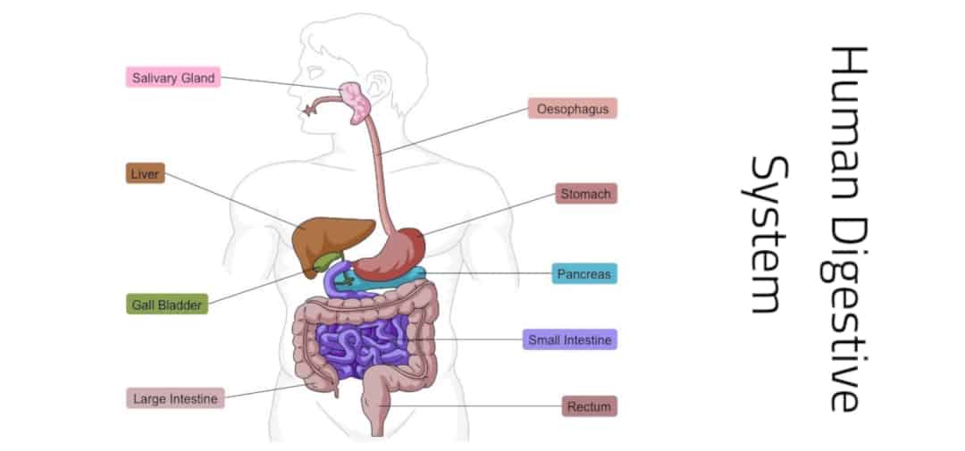
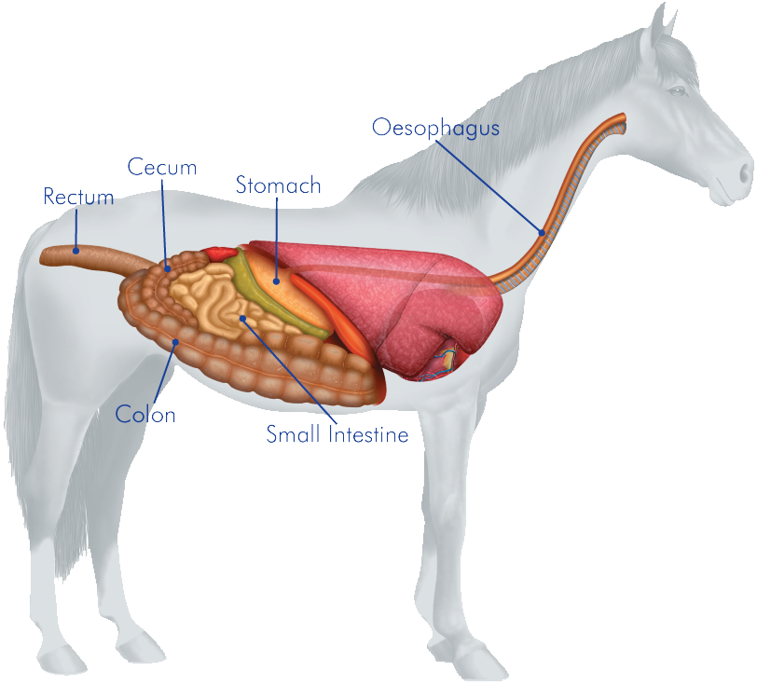
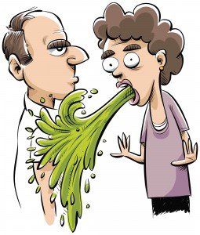
What do you take in Science about the Body
The Digestive System for example

Slide 6
What is the difference between these two?

Slide 7
Not Random
The letters stick to the board by magnetic force
But the “sequence” or the “order” of the letters is put by someone who knows the Alphabet

Slide 8
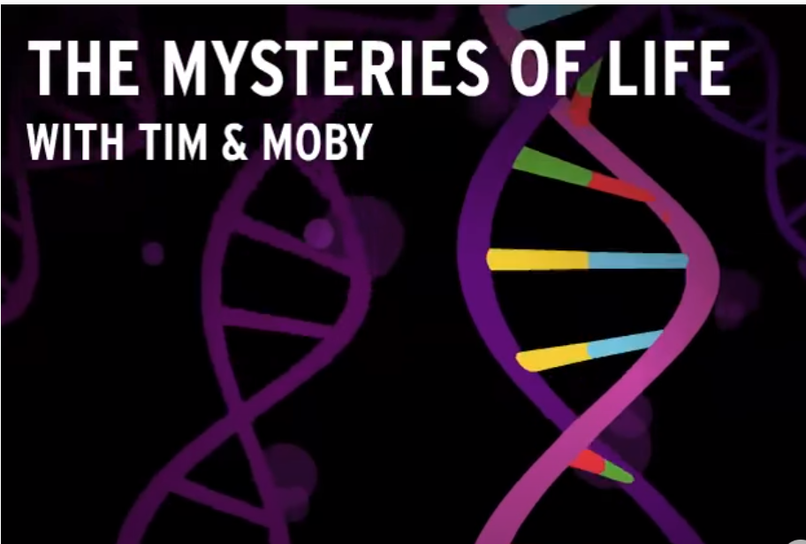
Let us learn a bit more from a movie Click on the picture to watch the movie
Pay attention to the part that says it is like a “book”
Indeed – each organism is like a book that is written
And this book is the DNA molecule

Slide 9
DNA
It is a small piece called a molecule that stays in every cell of your body

Slide 10
THE DNA is a LONG book
The rails of the DNA cell is like the magnet that holds things together
Or it is like the blank paper of a book that is written on
Someone who knows the order (like the Alphabet example) wrote that book

Slide 11
The “order ” of the letters
A
G
T
C
A
T
G
A

Slide 12
Each Species is its own book

Slide 13
It is exactly like “writing a book”
Except the Writer of the Book has only 4 letters to use
A
T
C
G

Slide 14
A book –
When you open a book what do you see? Or What is a book made of?
A book contains information that is written in the form of letters
There must be a MIND that has this Information

Slide 15
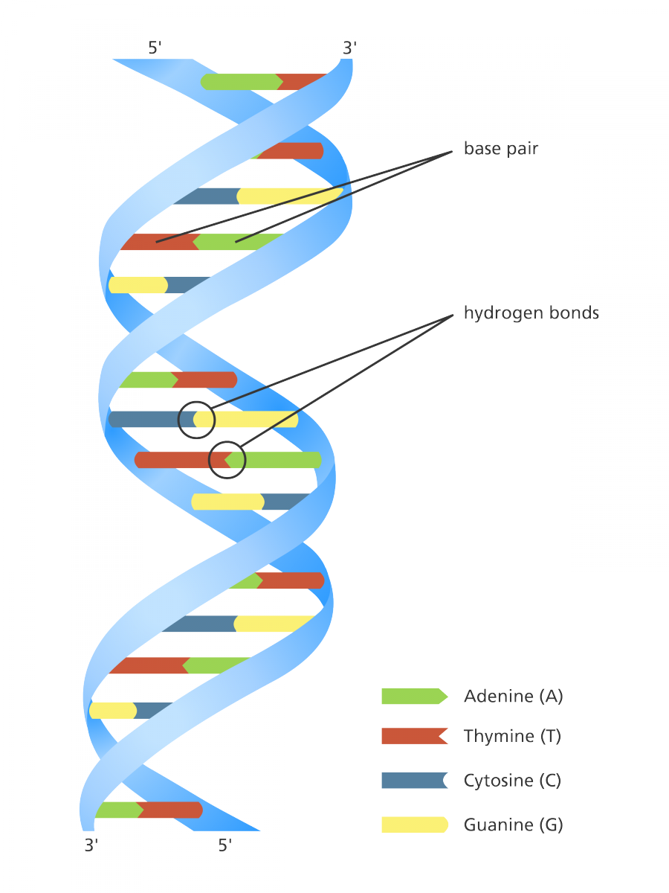
But You and I are different from any other creation
Or we can say: we are different from any other “book” that is written by God.
Do you know how?...
“And the Lord God formed man of the dust of the ground, and breathed into his nostrils the breath of life; and man became a living being.” (Genesis 2:7)

